Slide 1
iDelve
HACC 2016 – Jobs for Citizens with Disabilities – September 24, 2016
Empowering Hawaii job seekers with disabilities
to take control of their career journeys
TEAM MEMBERS
Ariana Stugard: Vision, UI/UX
Krislin Lee: Vision, Software Development
Ruby Menon: SME, Research
Andrew Wong: Software Development
Russ Tokuyama: Software Development
Ryan Kanno: Software Development
Notes:
I’m Krislin Lee, and my team’s HACC 2016 submission is iDelve,
Which is an accessible social app for skills tracking, that promotes self-awareness, self-confidence, self-growth, and community support
This was built to support the State’s integration employment initiatives.

Slide 2

What is Integrated Employment?
The Sandwich Shop
Job Seeker, Employment Specialist, Employer
Notes:
Integrated employment is when people with disabilities are able to work in for fair pay, alongside people without disabilities, with equal advancement opportunities.
Let me tell you a story about a sandwich shop employee.
Malia is working with Jennifer, her Employment Specialist
- Limited hours
- Set/repetitive duties
- Needs to work around people
Now Jennifer visited a local sandwich shop during her lunch hour, it was chaos.
the cashier was too busy multi-tasking to serve the customers
Jennifer came up with a plan, and presented a business proposal to Mr. Higa, the owner, about how hiring Malia to work during lunch hour will benefit his business
- Mr. Higa agreed
And it turned out to be the right decision
- Malia loved her job and people loved her
- Sales and customer satisfaction increased

Slide 3
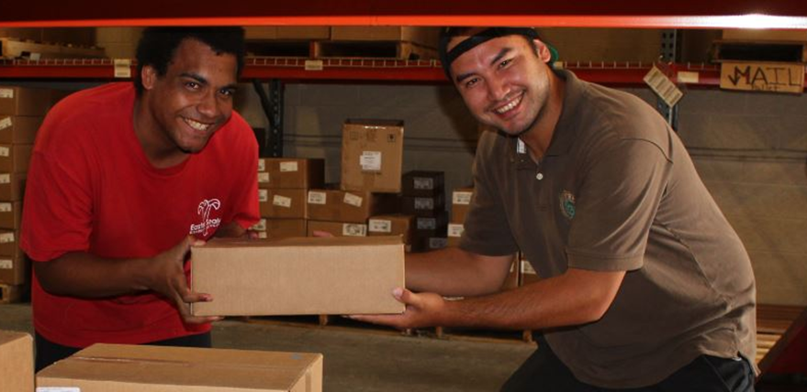
INTEGRATED EMPLOYMENT
Benefits Everyone
Notes:
This is just one example of how Integrated Employment benefits everyone. But the benefits run even deeper.

Slide 4
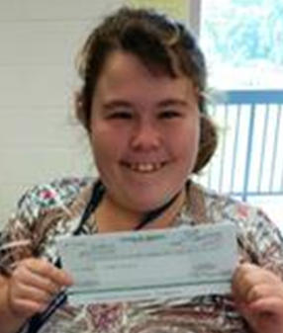
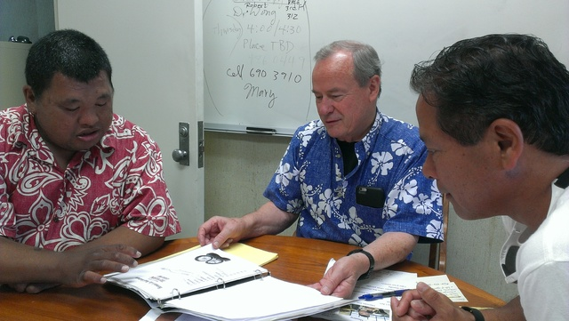
Employee
Employer
Society

Equality, self-esteem, belonging, valued social roles

 

Operational and financial benefits (9 out of 10)

Tax savings (4X returns), diversity
“Where this Wahiawa man leads, a community follows”
Honolulu Star-Advertiser; Lee Cataluna; August 26, 2016
Source: http://health.hawaii.gov/ddd/files/2015/02/Frame-Work.pdf
Notes:
Employee
-- equality, value, belonging, benefits their mental, emotional, physical health, may make some disabilities less disabling
Employer
-- as in the story, many benefits to be had
-- 9 out of 10 operational and financial benefits (innovations/optimizations)
Society
-- tax savings
-- diversity, perspectives

Slide 5
Employment First
Work is a fundamental life activity for adults with and without disabilities… it provides a sense of purpose, shaping who we are and how we fit into our community… All individuals, regardless of disability and age, can work and work optimally with opportunity, training, and support that builds on each person’s strengths and interests.
- CMS Informational Bulletin (September 16, 2011)
Notes:
The federal government has mandated the need for integrated employment
-- work considered fundamental life activity
-- pushing for meaningful employmental opportunities instead of institutions and sheltered workshops
-- this is the Employment First mandate

Slide 6
As of 2013, Integrated Employment participation is at 2%,
the LOWEST in the nation (average 19%).
Percent Participating in Integrated Employment Services by State, 2013
NATIONAL AVERAGE
HAWAII
Source: http://www.statedata.info/statepages/Hawaii
Notes:
Unfortunately, Hawaii is far behind the curve…
As of 2013, Hawaii’s Integration Employment participation was at a measly 2%
The Lowest in the nation
Things need to change

Slide 7

TIME IS RUNNING OUT: CMS Final Rules for HCBS funding
Hawaii has until March 17, 2019 to come into compliance
Or face federal sanctions
Notes:
And they need to change quickly!
Hawaii has less than 3 years to make dramatic improvements…
Or face federal sanctions

Slide 8
CUSTOMIZED EMPLOYMENT
Tailor job opportunities to clients’ strengths, needs, and interests
Notes:
But they do have a plan
Jessica Worster of the Developmental Disabilities Division has taken on the task of addressing this problem.
Learned from Washington State (the top in the nation) and is using the Customized Employment strategy

Slide 9







Support Team
Family
Assistant
Friends
Employment Specialist
Coworkers
Employer
Notes:
For Customized Employment to work well, the Employment Specialist needs to learn as much as they can about the job seeker.
Complete network
Balanced view of strengths, needs, and interests

Slide 10



JOB SEEKER
connect
develop
iDelve
JOB SPECIALIST
EMPLOYER
Igniting Dignity Empathy Love Value Esteem
inform
Notes:
We built iDelve to help in this process of discovery and career planning
iDelve consumer-focused app giving job seekers with full control and access to their career related information
Throughout this hackathon, we worked closely with the Department of Health and end users to design
an app that job seekers and their supports can use -- simple, accessible, easy to use – iPad is the target

Slide 11
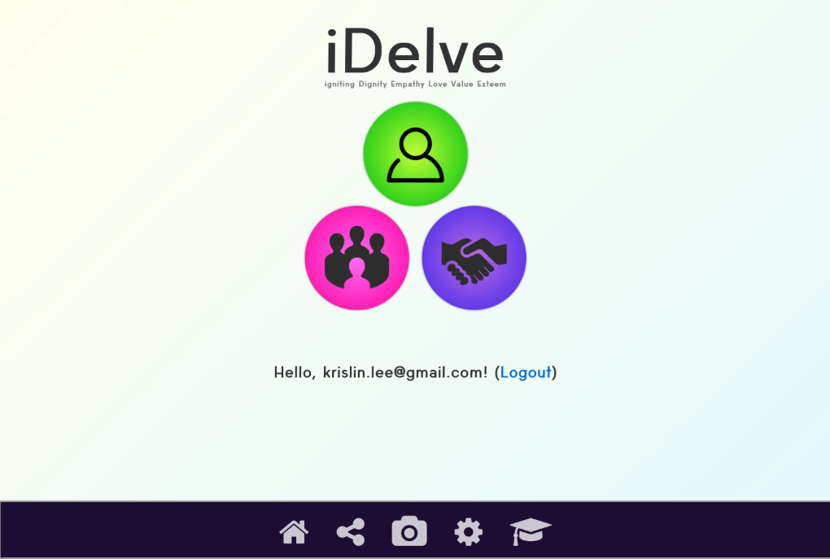
Place your screenshot here
START PAGE
Demo URL: https://idelve.herokuapp.com/ | Username: john.doe@mymail.com | Password: test1234
Notes:
Three main choices
My Profile
My Team
My Resume

Slide 12
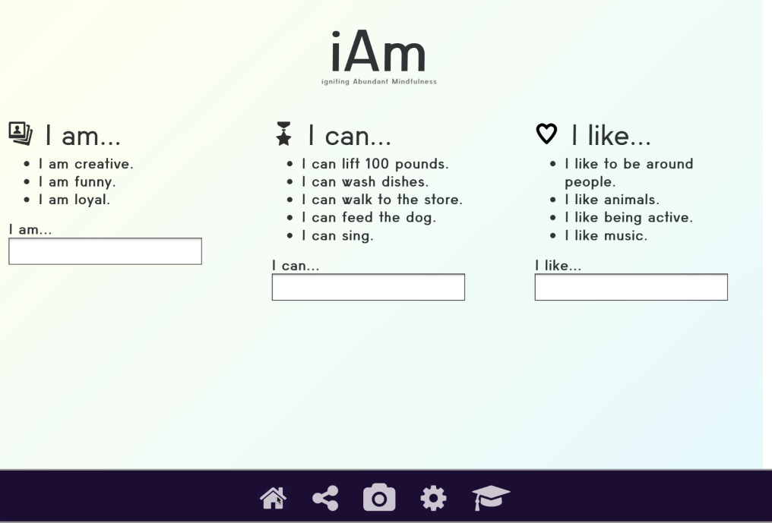
Place your screenshot here
MY PROFILE
Demo URL: https://idelve.herokuapp.com/ | Username: john.doe@mymail.com | Password: test1234
Notes:
My profile
We use simple prompts to help users provide information about themselves. While they may sound simple, these statements are actual a proven way to affirm a person’s value and promote their self-awareness, self-esteem, and self-confidence as they continually interact and reflect on them.
-- i am (personal traits)
-- i can (abilities/skills)
-- i like (interests)
-- interests improve job satisfaction, motivation, growth, and performance
-- overall
-- makes it easier for team to identify potential employment opportunities

Slide 13
Place your screenshot here
Demo URL: https://idelve.herokuapp.com/ | Username: john.doe@mymail.com | Password: test1234
Notes:
Select My Team

Slide 14
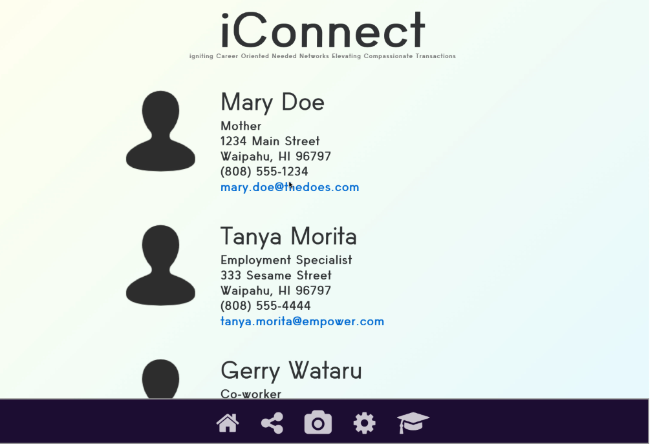
Place your screenshot here
MY TEAM
Demo URL: https://idelve.herokuapp.com/ | Username: john.doe@mymail.com | Password: test1234
Notes:
my team
-- contact info
-- collaborate to capture and post information on behalf of job seeker
-- network with each other

Slide 15
Place your screenshot here
Demo URL: https://idelve.herokuapp.com/ | Username: john.doe@mymail.com | Password: test1234
Notes:
Select My Resume

Slide 16
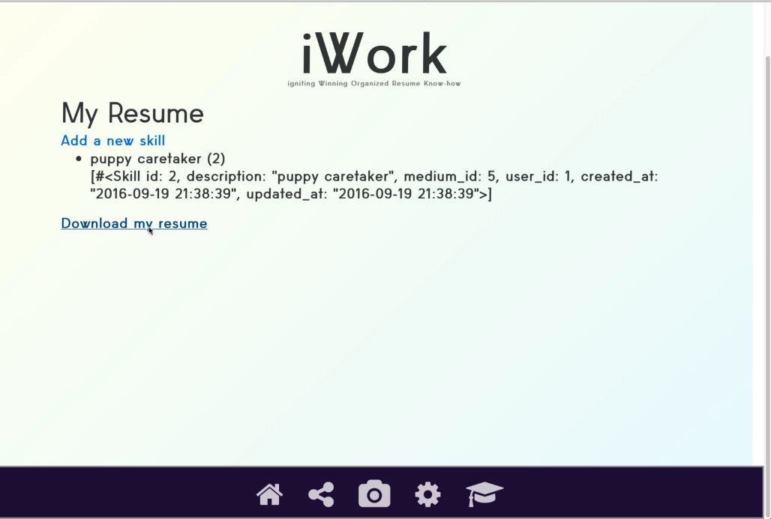
Place your screenshot here
MY RESUME
Demo URL: https://idelve.herokuapp.com/ | Username: john.doe@mymail.com | Password: test1234
Notes:
My Resume
-- take information from gathered through app
-- specify employable skills and personality traits
-- generate resume

Slide 17
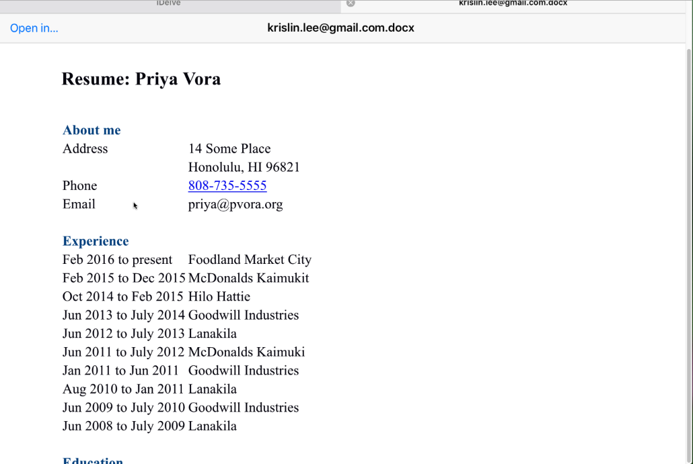
Place your screenshot here
MY RESUME
Demo URL: https://idelve.herokuapp.com/ | Username: john.doe@mymail.com | Password: test1234
Notes:
Word resume can be sent to employers, job specialist, or anyone else

Slide 18
Place your screenshot here
MY RESUME
Demo URL: https://idelve.herokuapp.com/ | Username: john.doe@mymail.com | Password: test1234

Slide 19
Place your screenshot here
TRAINING
Demo URL: https://idelve.herokuapp.com/ | Username: john.doe@mymail.com | Password: test1234
Notes:
-- a career is a journey
-- gain confidence and pursue learning opportunities
-- training modules
-- intial focus being social/soft skills since these opens lots of doors and opportunities to show off your strengths
-- also provide training for support team and job specialists
-- integrate with learning providers to provide high-value content

Slide 20
SUSTAINABILITY & GROWTH
Where do we go from here?
Notes:
Since this is a consumer-driven app, this would be run and maintained through the private sector
though it could initially be indirectly funded through state employment support programs through premium subscription fees and payment for training content.
However, there is a lot of growth potential

Slide 21
EXPANDED DEMOGRAPHIC: Accessible Skills Tracking Social Network
Everyone
Disadvantaged Job Seekers

Other disabilities
Professionals
Rehabilitated prisoners
Developmental Disabilities
Homeless
Students
Veterans with PTSD
Minorities
Anyone interested in self-improvement
Supportive community of learners
Notes:
Initial focus: Developmental disabilities
Could extend to other disadvantaged job seekers, eventually everyone
Accessible software is good design for everyone!
And this also would help in the goal of bringing people with disabilities into a larger integrated community.
Aim to create a sustainable supportive community of learners

Slide 22
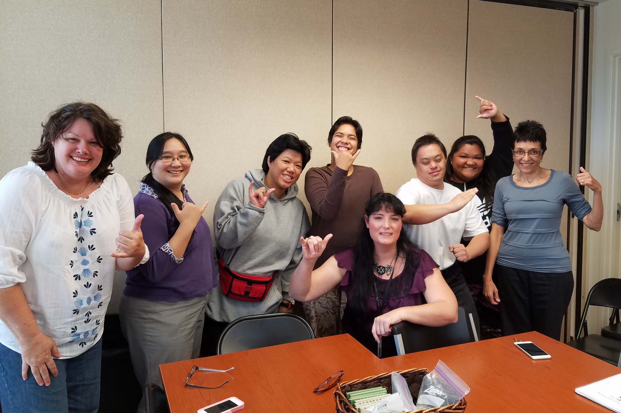
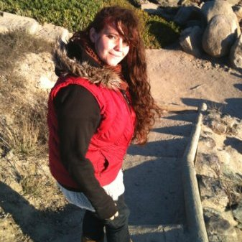
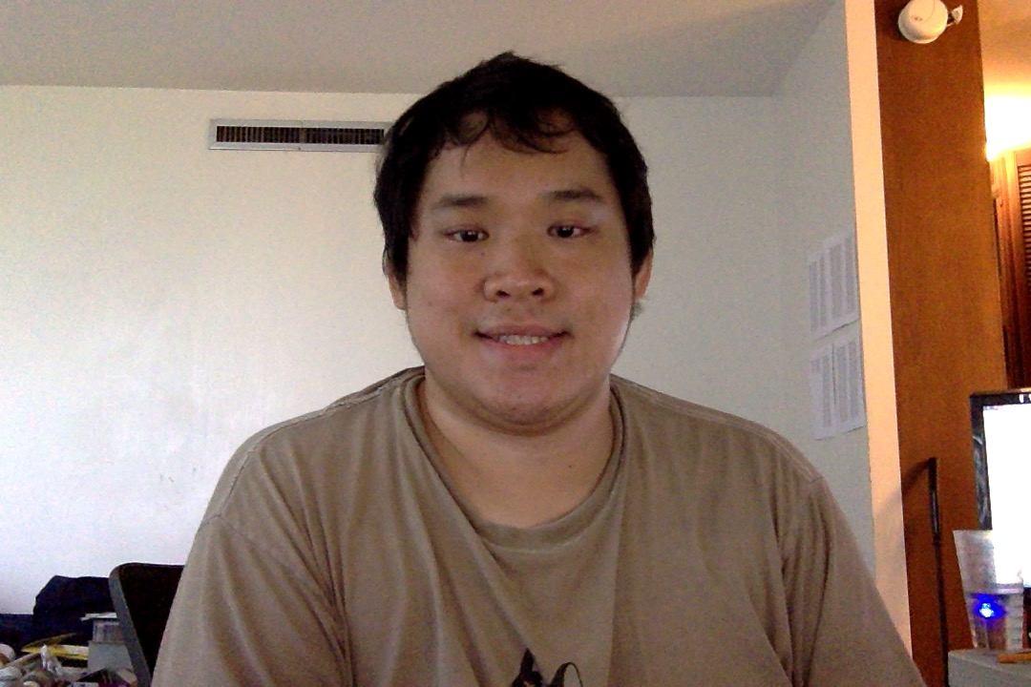
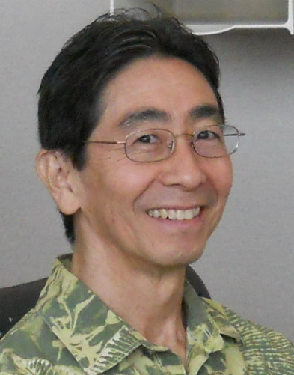
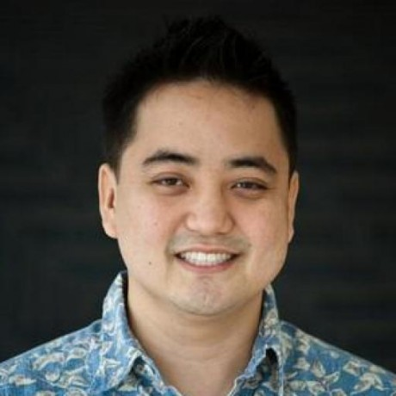
Mahalo!
The iDelve Team: Ari, Krislin, Ruby, Andrew, Russ, and Ryan
Notes:
-- Support the Department of Health and DDD’s efforts
-- Promote awareness of the abilities of people with DD
-- Support our app :-D

Slide 23
CREDITS
Special thanks to all the people who made and released these awesome resources for free:
Presentation template by SlidesCarnival
Photographs by Unsplash

